Slide 1
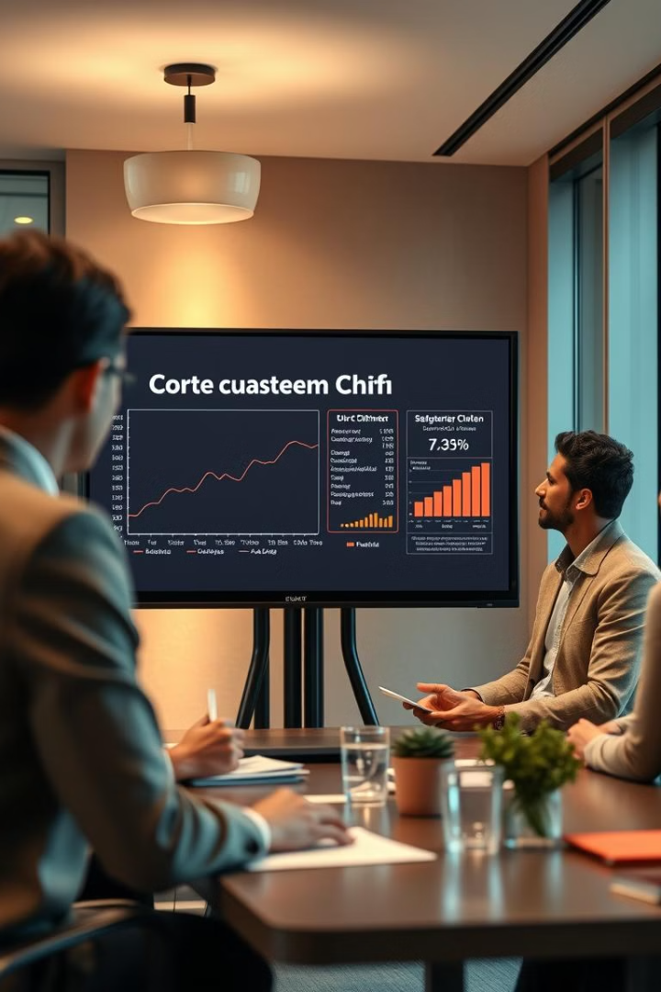
Telecommunication Churn Prediction
Predicting customer churn is crucial for business success.
Project: P494
Presented By: Group 2
1.Snehal Gawade
2.Abhi
3.Anil
4.Kiran
5.Bhargav Pataudi
6.Shaik Zabrulla Basha
7.Siddharth

Slide 2



Understanding Customer Churn
What is Churn?
Why It Matters
Project Goal
In telecommunications, churn refers to customers who cancel their subscriptions or switch to a competitor's service.
Retaining valuable customers reduces acquisition costs and ensures a stable revenue stream for the telecommunication company.
Predict the probability of customer churn using machine learning models.

Slide 3
Dataset Overview
Customer Churn Dataset
Key Features
Target Variable
This dataset contains customer information relevant to predicting churn in a telecommunications company.
Account Length: Duration of customer's account in months.
Churn: Indicates whether the customer churned (Yes/No).
VMail Message: Number of voice mail messages.
This is the variable our model aims to predict.
Day Minutes: Total minutes of daytime calls.
Night Calls: Number of calls made during the night.
Customer Service Calls: Number of calls made to customer service.
International Plan: Whether the customer has an international plan (yes/no).

Slide 4




Data Preprocessing Steps
Missing Values
Handling and imputation.
Categorical Variables
Conversion to numerical.
Feature Scaling
Normalization if needed.

Slide 5


Model Selection & Training
Algorithm
Hyperparameter Tuning
Metrics
We chose Random Forest for its robustness and ability to handle non-linear relationships in the data.
We evaluated the model using Accuracy, Precision, Recall, and F1-score to ensure balanced performance.
We used GridSearchCV to optimize hyperparameters, focusing on 'n_estimators', 'max_depth', and 'min_samples_split'.

Slide 6




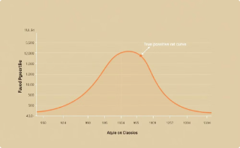
Model Evaluation
Accuracy: 0.9205
Precision: 1.00
Recall: 0.87
F1-Score: 0.9082
High overall correctness of the model.
The model has no false positives.
The model correctly captured most of the positive cases.
The harmonic mean of precision and recall, providing a balanced score.
ROC AUC Score: 0.84
Excellent ability to distinguish between classes.

Slide 7



Deployment Overview
Train & Save Model
Web Interface
Local Server
Train the machine learning model and save it for later use.
Develop a web interface to interact with the model.
Deploy the model on a local server to make predictions.

Slide 8
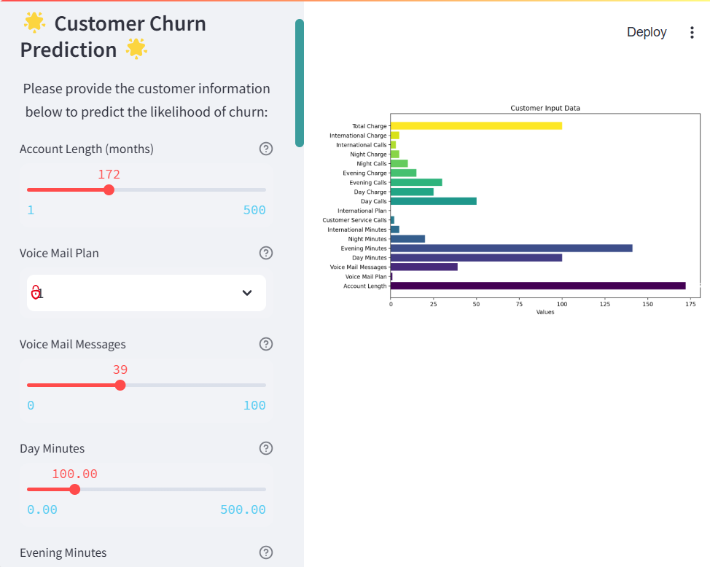
Streamlit Implementation
1
User Inputs
Account length, Call minutes
2
Prediction Output
Churn likelihood.
3
Visualization
Charts and metrics.

Slide 9

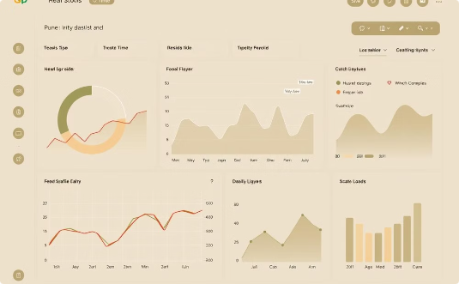

Streamlit Demo: Churn Prediction
Key Metrics
Real-Time Analysis
User Experience
Demonstrates key inputs influencing churn prediction.
Provides dynamic predictions based on varying customer profiles.
Offers an intuitive interface for ease of use.

Slide 10

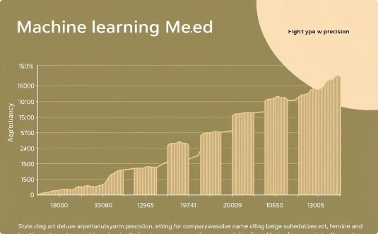
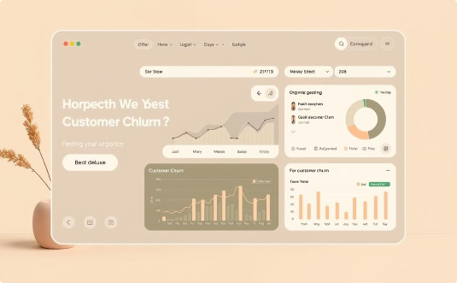
Conclusion & Future Scope
Data Insights
Model Performance
Streamlit App
Comprehensive dataset enables in-depth churn analysis and informed decisions.
Robust model delivers high accuracy predictions, enhancing business outcomes.
Intuitive interface provides real-time churn analysis for ease of use.
Future Improvements: Implement deep learning for enhanced accuracy, integrate with real-time customer data, and deploy using Docker & Cloud platforms.

Slide 11

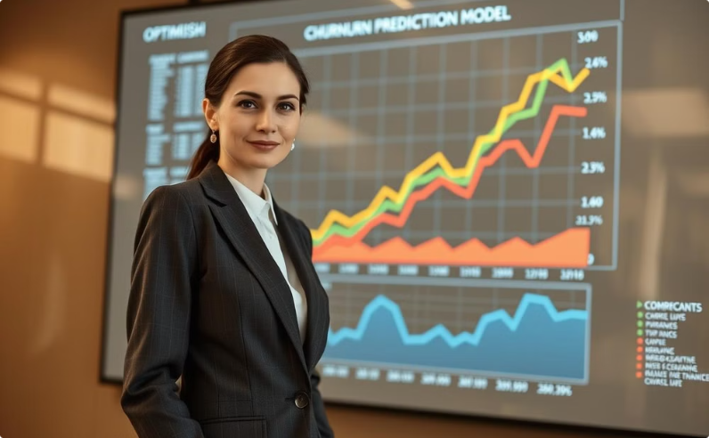
Thank You!
Valuable Dataset
Impactful Model
Gratitude for providing the dataset.
This churn prediction model optimizes customer retention and improves business outcomes.
Thank you!

